Slide 1
Context Free Grammar

Slide 2
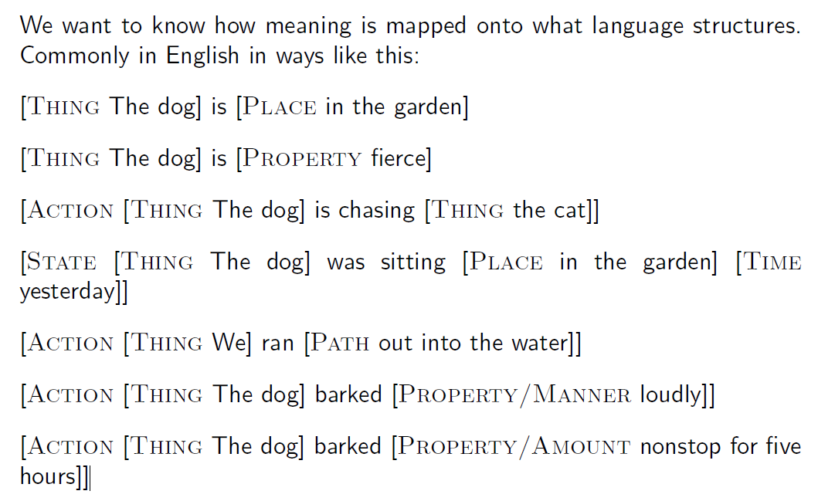
Language structure and meaning

Slide 3
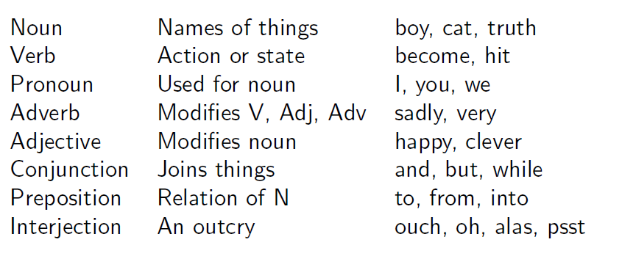
Word categories: Traditional parts of speech

Slide 4
Constituency
The idea: Groups of words may behave as a single unit or phrase, called a constituent.
E.g. Noun Phrase
Kermit the frog
they
December twenty-sixth
the reason he is running for president

Slide 5
Constituency
Sentences have parts, some of which appear to have subparts. These groupings of words that go together we will call constituents.
I hit the man with a cleaver
I hit [the man with a cleaver]
I hit [the man] with a cleaver
You could not go to her party
You [could not] go to her party
You could [not go] to her party

Slide 6
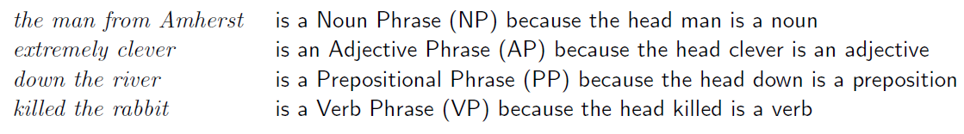
Constituency Phrases
For constituents, we usually name them as phrases based on the word that heads the constituent:
Sometimes words also act as phrases. Eg:
Joe grew potatoes.
Joe and potatoes are both nouns and noun phrases.
Compare with:
The man from Amherst grew beautiful russet potatoes.
We say Joe counts as a noun phrase because it appears in a place that a larger noun phrase could have been.

Slide 7
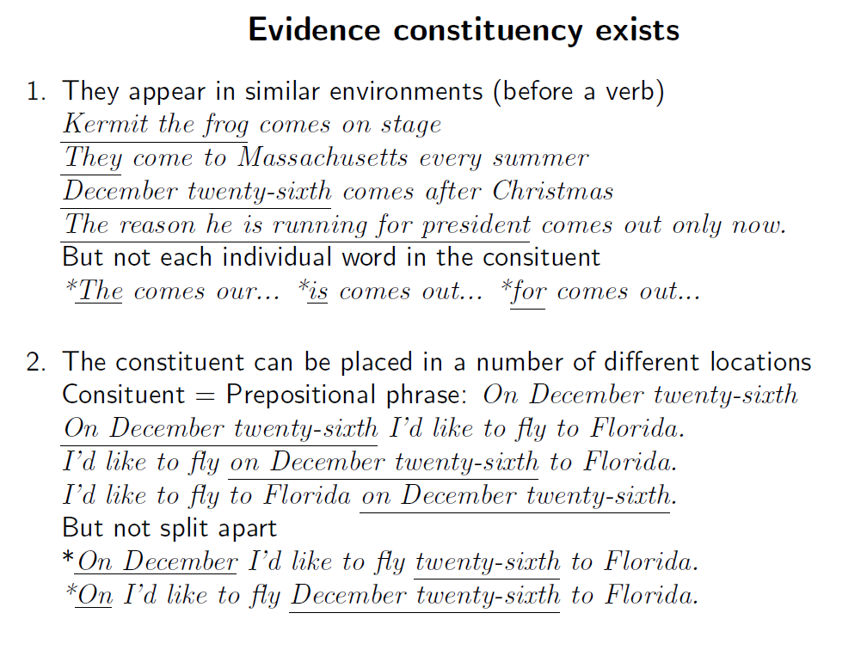

Slide 8
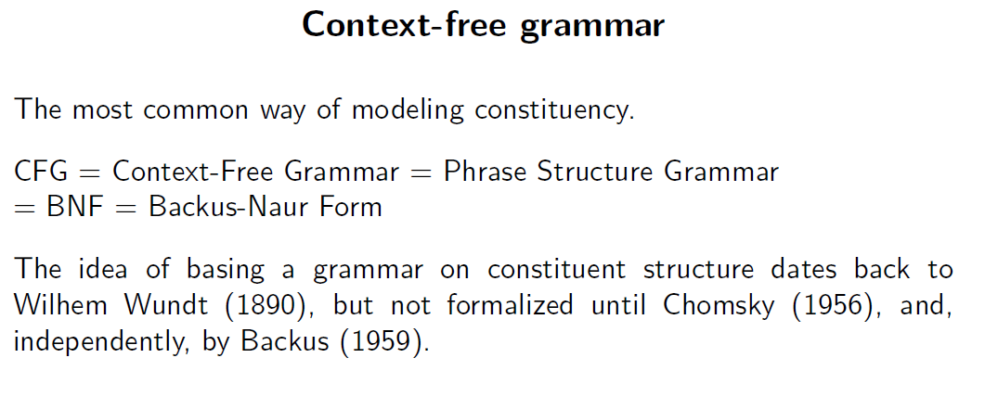

Slide 9
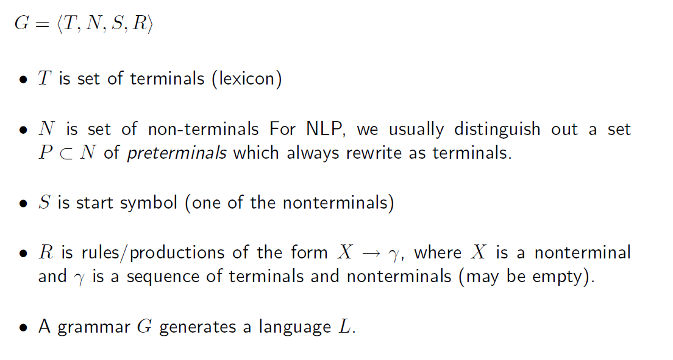
Context Free Grammar

Slide 10
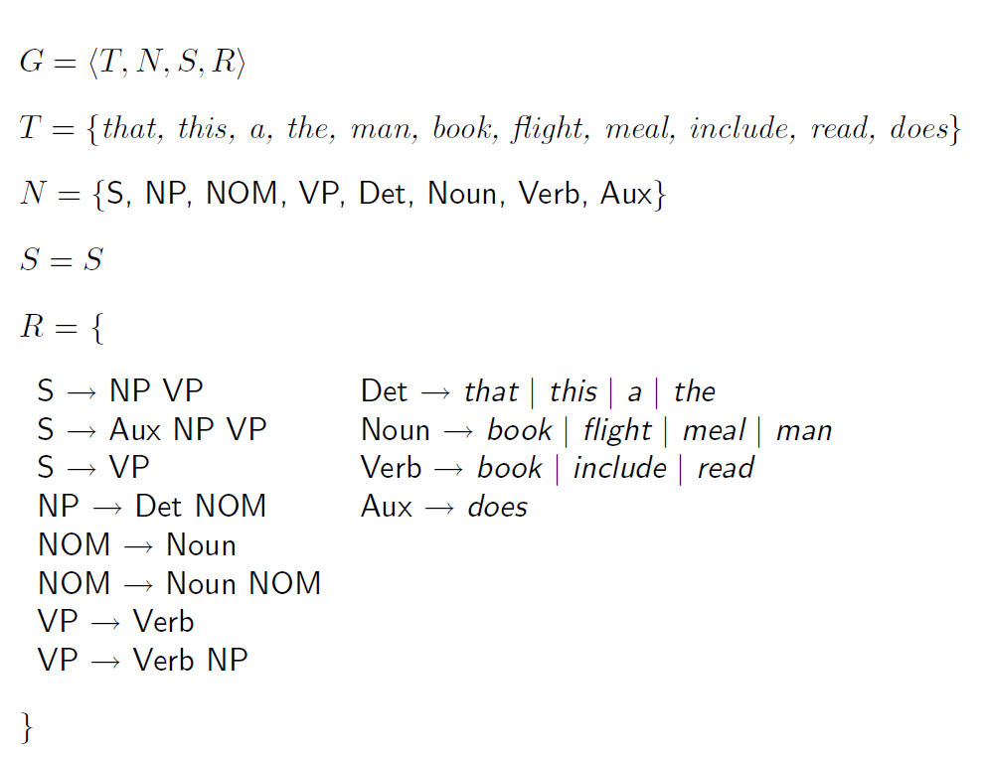
Example of CFG

Slide 11
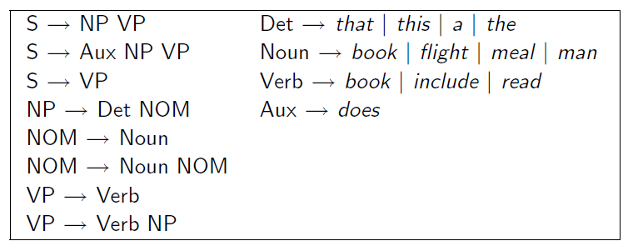
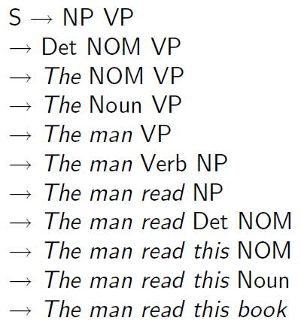
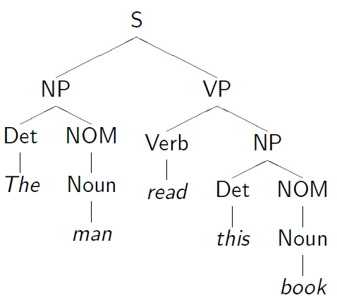

Slide 12
Parsing
Process of taking string and grammar and generating all possible parse trees for that string is called parsing
Types of parsing
Top down parsing (Goal Oriented)
Bottom up parsing (Data Oriented)
A parser is sound if every parse it returns is valid/correct.
A parser terminates if it is guaranteed not to go off into an infinite loop.
A parser is complete if for any given grammar and sentence it is sound, produces every valid parse for that sentence, and terminates.

Slide 13
Top down parser
A top-down parser searches for a parse tree by trying to build from the root node S down to the leaves.
Initial Trees: Identify all trees that can start with S by checking grammar rules with S on the left hand side.
Grow Trees: Expand trees downward using these rules until they reach the POS categories at the bottom.
Match Input: Reject trees whose leaves do not match the input words.

Slide 14
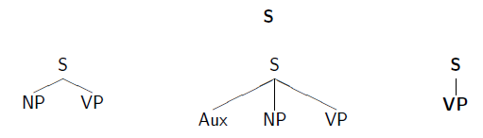
Top down parser – example 1
Sentence - Book that flight
1st iteration

Slide 15
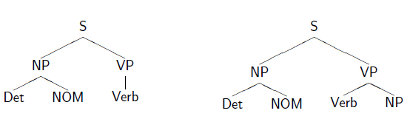
Sentence - Book that flight
1st iteration
2nd iteration

Slide 16
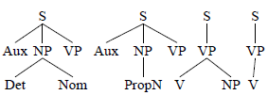
Sentence - Book that flight
2nd iteration
3rd iteration

Slide 17
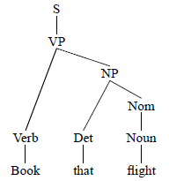
Sentence - Book that flight
4th iteration

Slide 18
Top down parser – example 2
“The dog saw a man in the park”
Use the following grammar rules to create the parse tree:
S → NP VP
NP → Det N | Det N PP | PNoun | N
VP → Verb NP | Verb NP PP
PP → Prep NP
Verb → saw | ate | walked
PNoun → Ramesh | Raj | Anita
Det → a | an | the
N → man | dog | cat | telescope | park
Prep → in | on | by | with

Slide 19
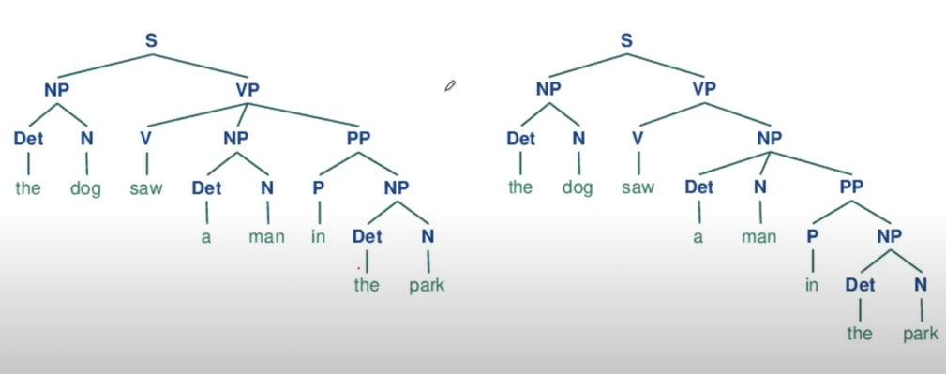
Top down parser – example 2

Slide 20
Bottom up parser (data directed)
The parser starts with the input words and builds trees upward.
Start with words: Begin with the words of the input
Apply Rules: Build trees by applying grammar rules one at a time.
Fit Rules: Look for places in the current parse where the RHS of a rule can fit.

Slide 21

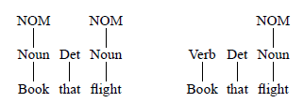
Bottom up parser – example 1
Sentence - Book that flight
1st iteration
2nd iteration

Slide 22
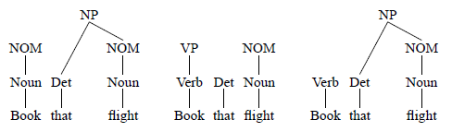
Bottom up parser – example 1
Sentence - Book that flight
2nd iteration
3rd iteration

Slide 23
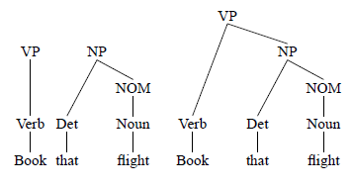
Bottom up parser – example 1
Sentence - Book that flight
3rd iteration
4th iteration

Slide 24


Bottom up parser – example 2
Sentence - “Rahul is eating an apple”
Use the following grammar rules to create the parse tree:
S → NP VP
NP → Det N | N
VP → Aux VP
VP → V NP
Aux → is
V→ eating
N → Rahul | apple
Det → an

Slide 25

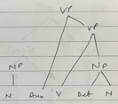
Bottom up parser – example 2
Sentence - “Rahul is eating an apple”
Use the following grammar rules to create the parse tree:
S → NP VP
NP → Det N | N
VP → Aux VP
VP → V NP
Aux → is
V→ eating
N → Rahul | apple
Det → an

Slide 26
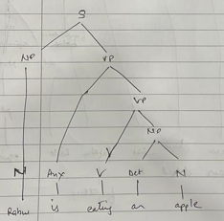
Bottom up parser – example 2
Sentence - “Rahul is eating an apple”
Use the following grammar rules to create the parse tree:
S → NP VP
NP → Det N | N
VP → Aux VP
VP → V NP
Aux → is
V→ eating
N → Rahul | apple
Det → an

Slide 27
Top-down/Bottom-up Parsing
 | Top-down (recursive decent parser) | Bottom-up (shift-reduce parser)
Starts from | S (goal) | Words (input)
Algorithm (Parallel) | a. Pick non-terminals b. Pick rules from the grammar to expand the non-terminals | a. Match sequence of input symbols with the RHS of some rule b. Replace the sequence by the LHS of the matching rule
Termination | Success: When the leaves of a tree match the input Failure: No more non-terminals to expand in any of the trees | Success: When “S” is reached Failure: No more rewrites possible
Pros/Cons | Pro: Goal-driven, starts with “S” Con: Constructs trees that may not match input | Pro: Constrained by the input string Con: Constructs constituents that may not lead to the goal “S”
Control strategy -- how to explore search space?
Pursuing all parses in parallel or backtrack or …?
Which rule to apply next?
Which node to expand next?
Look at how the Top-down and Bottom-up parsing works on the board for “Book that flight”

Slide 28
Cocke-Younger-Kasami Parser
Bottom-up parser with top-down filtering
Start State(s): (A, i, i+1) for each A→w_{i+1}
End State: (S, 0,n) n is the input size
Next State Rules
(B, i, k) (C, k, j) → (A, i, j) if A→BC

Slide 29
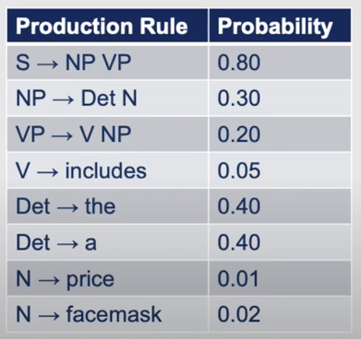
The price includes a facemask
 | 1-the | 2-price | 3-includes | 4-a | 5-facemask
0
1
2
3
4
We begin by finding a single phrase match in the grammar rules.
We look for all the words in the sentence one at a time and fill the corresponding table entry

Slide 30
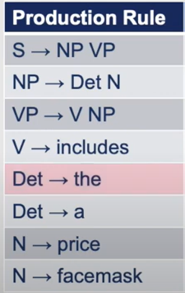
The price includes a facemask
 | 1-the | 2-price | 3-includes | 4-a | 5-facemask
0 | Det
1
2
3
4

Slide 31
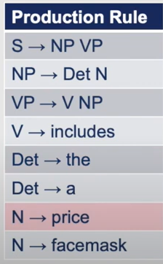
The price includes a facemask
 | 1-the | 2-price | 3-includes | 4-a | 5-facemask
0 | Det
1 |  | N
2
3
4

Slide 32
The price includes a facemask
 | 1-the | 2-price | 3-includes | 4-a | 5-facemask
0 | Det
1 |  | N
2 |  |  | V
3 |  |  |  | Det
4 |  |  |  |  | N
Now, we have filled the single word entries and move ahead with the two word entries e.g "the price"
We look for a rule that has Det N on the right hand and find it in rule 2. So we make a note of it in cell (0,1)

Slide 33
The price includes a facemask
 | 1-the | 2-price | 3-includes | 4-a | 5-facemask
0 | Det | NP
1 |  | N
2 |  |  | V
3 |  |  |  | Det
4 |  |  |  |  | N
Now, we have filled the single word entries and move ahead with the two word entries e.g "the price"
We look for a rule that has Det N on the right hand and find it in rule 2. So we make a note of it in cell (0,1)

Slide 34
The price includes a facemask
 | 1-the | 2-price | 3-includes | 4-a | 5-facemask
0 | Det | NP
1 |  | N | X
2 |  |  | V | X
3 |  |  |  | Det | NP
4 |  |  |  |  | N
We then look for a N V match, however we don’t get any
Moving ahead, we look for V Det, again no match
Then Det N, and like earlier get a match

Slide 35
The price includes a facemask
 | 1-the | 2-price | 3-includes | 4-a | 5-facemask
0 | Det | NP
1 |  | N | X
2 |  |  | V | X
3 |  |  |  | Det | NP
4 |  |  |  |  | N
Moving on to "the price includes"

Slide 36
The price includes a facemask
 | 1-the | 2-price | 3-includes | 4-a | 5-facemask
0 | Det | NP
1 |  | N | X
2 |  |  | V | X
3 |  |  |  | Det | NP
4 |  |  |  |  | N
Moving on to "the price includes"

Slide 37
The price includes a facemask
 | 1-the | 2-price | 3-includes | 4-a | 5-facemask
0 | Det | NP | X
1 |  | N | X
2 |  |  | V | X
3 |  |  |  | Det | NP
4 |  |  |  |  | N
Moving on to "the price includes"

Slide 38
The price includes a facemask
 | 1-the | 2-price | 3-includes | 4-a | 5-facemask
0 | Det | NP | X
1 |  | N | X
2 |  |  | V | X
3 |  |  |  | Det | NP
4 |  |  |  |  | N
Moving on to "the price includes a"

Slide 39
The price includes a facemask
 | 1-the | 2-price | 3-includes | 4-a | 5-facemask
0 | Det | NP | X
1 |  | N | X
2 |  |  | V | X
3 |  |  |  | Det | NP
4 |  |  |  |  | N
Moving on to "the price includes a"

Slide 40
The price includes a facemask
 | 1-the | 2-price | 3-includes | 4-a | 5-facemask
0 | Det | NP | X
1 |  | N | X
2 |  |  | V | X
3 |  |  |  | Det | NP
4 |  |  |  |  | N
Moving on to "the price includes a"

Slide 41
The price includes a facemask
 | 1-the | 2-price | 3-includes | 4-a | 5-facemask
0 | Det | NP | X
1 |  | N | X | X
2 |  |  | V | X
3 |  |  |  | Det | NP
4 |  |  |  |  | N
Moving on to "the price includes a"

Slide 42
The price includes a facemask
 | 1-the | 2-price | 3-includes | 4-a | 5-facemask
0 | Det | NP | X
1 |  | N | X | X
2 |  |  | V | X
3 |  |  |  | Det | NP
4 |  |  |  |  | N
Moving on to last three constituents "includes a facemask"

Slide 43
The price includes a facemask
 | 1-the | 2-price | 3-includes | 4-a | 5-facemask
0 | Det | NP | X
1 |  | N | X | X
2 |  |  | V | X
3 |  |  |  | Det | NP
4 |  |  |  |  | N
Moving on to last three constituents "includes a facemask"

Slide 44
The price includes a facemask
 | 1-the | 2-price | 3-includes | 4-a | 5-facemask
0 | Det | NP | X
1 |  | N | X | X
2 |  |  | V | X | VP
3 |  |  |  | Det | NP
4 |  |  |  |  | N
Moving on to last three constituents "includes a facemask"
We find a match for V NP

Slide 45
The price includes a facemask
 | 1-the | 2-price | 3-includes | 4-a | 5-facemask
0 | Det | NP | X
1 |  | N | X | X
2 |  |  | V | X | VP
3 |  |  |  | Det | NP
4 |  |  |  |  | N
"the price includes a" all the highlighted options are impossible

Slide 46
The price includes a facemask
 | 1-the | 2-price | 3-includes | 4-a | 5-facemask
0 | Det | NP | X | X
1 |  | N | X | X
2 |  |  | V | X | VP
3 |  |  |  | Det | NP
4 |  |  |  |  | N
"the price includes a" all the highlighted options are impossible

Slide 47
The price includes a facemask
 | 1-the | 2-price | 3-includes | 4-a | 5-facemask
0 | Det | NP | X | X
1 |  | N | X | X
2 |  |  | V | X | VP
3 |  |  |  | Det | NP
4 |  |  |  |  | N
"the price includes a facemask"

Slide 48
The price includes a facemask
 | 1-the | 2-price | 3-includes | 4-a | 5-facemask
0 | Det | NP | X | X
1 |  | N | X | X
2 |  |  | V | X | VP
3 |  |  |  | Det | NP
4 |  |  |  |  | N
"the price includes a facemask" all highlighted matches are impossible

Slide 49
The price includes a facemask
 | 1-the | 2-price | 3-includes | 4-a | 5-facemask
0 | Det | NP | X | X
1 |  | N | X | X | X
2 |  |  | V | X | VP
3 |  |  |  | Det | NP
4 |  |  |  |  | N
"the price includes a facemask"

Slide 50
The price includes a facemask
 | 1-the | 2-price | 3-includes | 4-a | 5-facemask
0 | Det | NP | X | X
1 |  | N | X | X | X
2 |  |  | V | X | VP
3 |  |  |  | Det | NP
4 |  |  |  |  | N
For the entire input , yellow shows impossible match

Slide 51
The price includes a facemask
 | 1-the | 2-price | 3-includes | 4-a | 5-facemask
0 | Det | NP | X | X | S
1 |  | N | X | X | X
2 |  |  | V | X | VP
3 |  |  |  | Det | NP
4 |  |  |  |  | N
For the entire input , we get a match and calculate the probabilities

Slide 52
a pilot likes flying planes
S → NP VP
VP → VBG NNS
VP → VBZ VP
VP → VBZ NP
NP → DT NN
NP → JJ NNS
DT → a
NN → pilot
VBZ → likes
VBG → flying
JJ → flying
NNS → planes
 | a | pilot | likes | flying | planes
0 | Det | NP | X | X | S1, S2
1 |  | NN | X | X | X
2 |  |  | VBZ | X | VP1, VP2
3 |  |  |  | VBG, JJ | VP, NP
4 |  |  |  |  | NNS

Slide 53

Probabilistic CFGs
A probabilistic CFG is a 5-tuple grammar G = (N, ∑, P, S, D)
Where
a set of nonterminal symbols (or ‘variables’) N
a set of terminal symbols ∑ (disjoint from N)
a set of productions P of the form A→β [p]
a designated start symbol S
D is a function assigning probabilities to each rule in P. This function expresses the probability p that the given nonterminal A will be expanded to the sequence β
This function expresses the proba bility p that the given nonterminal A will be expanded to the sequence β
Or
Formally this is conditional probability of a given expansion given the left-hand-size nonterminal A

Slide 54
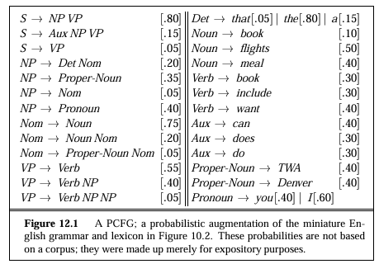
PCFG example
For all the possible expansions of a nonterminal, the sum of their probabilities must be 1

Slide 55


How to use the probabilities
The probability of a particular parse T is defined as the product of the probabilities of all the rules r used to expand each node n in the parse tree:
The resulting probability P(T|S) is both the joint probability of the parse and the sentence, and also the probability of the parse P(T).
How can this be true?
First, by the definition of joint probability:
P(T, S) = P(T) . P(S|T)
But since a parse tree includes all the words of the sentence, P(S|T) is 1. Thus:
P(T, S) = P(T) . P(S|T) = P(T)
The probability for all different parse trees is computed and the algorithm picks the best tree for a sentence S out of the set of parse trees for S.
We want the parse tree T which is most likely given the sentence S

Slide 56



By definition, the probability P(T|S) = P(T, S)/P(S), thus
For the same sentence P(S) is constant, therefore
Furthermore, since we showed above that P(T, S) = P(T), the final equation for choosing the most likely parse simplifies to choosing the parse with the highest probability

Slide 57
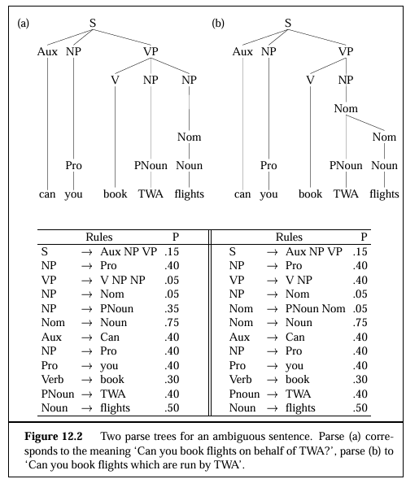
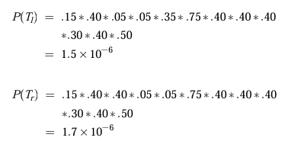
We can see that the right tree in Figure 12.2(b) has a higher probability.
Thus this parse would correctly be chosen by a disambiguation algorithm which selects the parse with the highest PCFG probability.

Slide 58
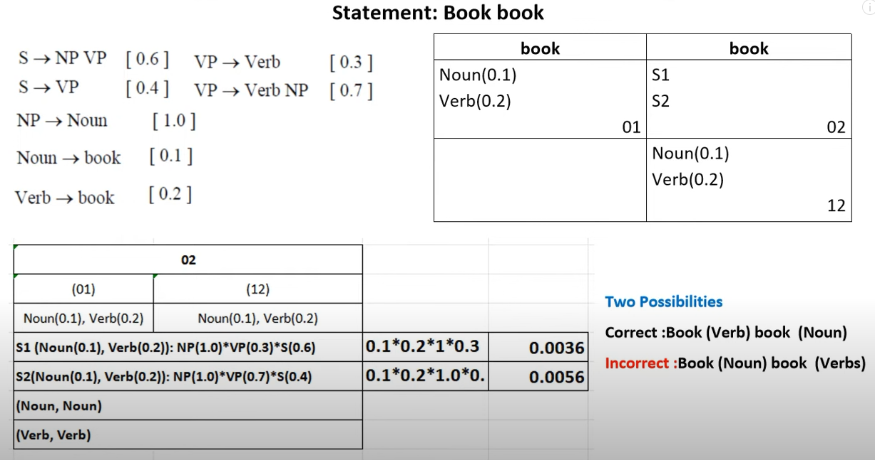

Slide 59
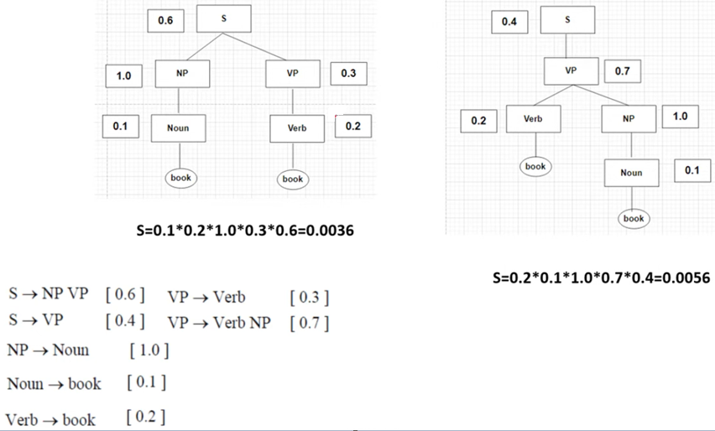

Slide 60
The price includes a facemask
 | 1-the | 2-price | 3-includes | 4-a | 5-facemask
0 | Det (0.40) | NP (0.3 * 0.4 * 0.01 = 0.0012) | X | X | S (0.8 * 0.0012 * 0.000024 = 2.304*10e-8
1 |  | N (0.01) | X | X | X
2 |  |  | V (0.05) | X | VP (0.2 * 0.05 * 0.0024 = 0.000024)
3 |  |  |  | Det (0.40) | NP (0.3 * 0.4 * 0.02 = 0.0024)
4 |  |  |  |  | N (0.02)
For the entire input , we get a match and calculate the probabilities

